Slide 1
aeap2i
Notes:
[This work by American Evaluation Association is licensed under a Creative Commons Attribution-NonCommercial-ShareAlike 3.0 Unported License. Based on a work at http://p2i.eval.org/.]
[THIS PRESENTATION IS DESIGNED TO LAST ABOUT 45 MINUTES. YOU SHOULD CUSTOMIZE IT TO YOUR OWN SITUATION PRIOR TO PRESENTING, PARTICULARLY ADJUSTING THE LAST SLIDES RELATED TO A CALL TO ACTION. THE SCRIPT HERE IS ONLY A SUGGESTION. BRACKETED, ALL CAPS WORDS ARE NOTES TO THE SPEAKER, NOT TO BE READ ALOUD]
Hi and welcome. We’re here together as part of the Potent Presentations Initiative to talk about how we can improve our presentation skills, both here at the conference and outside of here, when you are working to disseminate your evaluation.

Slide 2
Notes:
Potent Presenters think about 3 things: message, design, and delivery.

Slide 3
Notes:
Today we’re here to talk about delivery.
[Distribute handout]
The handouts for this session are being distributed now and are also posted on the p2i website.

Slide 4
4P & 2A
Prep
Audience
Pace
All Hell
Personal
Pose
Notes:
AEA culled the best advice on good presentations from the evidence of the field.
But to be honest, the empirical evidence is pretty sparse. AEA commissioned a literature review of peer-reviewed studies on rhetoric and public speaking and scraped together a bit, but I want to warn you that it was pretty weak. So we’re supplementing that with two other sources of data:
A commissioned study that interviewed 12 of the top AEA presenters
And AEA member solicited input about the good, the bad, and the ugly of presentation delivery.
Between all of those sources, we’ve amassed six key points that act as delivery glue, binding your audience to your words, to talk about in the next 45 minutes. We are fondly calling those six key points, 4P & 2A.
[CLICK] The 4P are Prep, Pace, Personal, and Pose. [CLICK] And the 2A are Audience and the ever-important All Hell. Let me use the last A there to justify the presentation’s title, Delivery Glue.

Slide 5
Delivery
Glue
Notes:
Essentially, we want to spend the moments we are speaking working to get the audience glued to you, your material glued to their brain. College professors sometimes say they need to get attention by being as animated as a video game or as smooth as Steve Jobs. Sure, that can be effective, but it isn’t the only way to glue.
At the core, delivery glue is about increasing your management of the room and reducing the unnecessary distractions during the talk. Now, sometimes things are severely interrupted, so we’ll discuss how to keep your cool when all hell breaks loose, but that’s the last A. Let’s start with the first P.

Slide 6
Prep
Notes:
Preparation. A great deal of awesome delivery is actually prepared ahead of time. Aside from the prep work to craft a message and design great slides, delivery is also rehearsed.

Slide 7
PRACTICE. Practice your presentation (out loud) before you present.
Notes:
And you said it. You said: “PRACTICE. Practice your presentation (out loud) before you present. This helps you figure out what you want to say, which slides are superfluous or out of order, and your timing. To me, it’s obvious when a presenter has practiced and when he/she has not.”
The Dynamic Dozen – those 12 top AEA presenters – also discussed the need for practice. They recommended practicing in front of different groups. Now, different practice audiences have different purposes. Colleagues, for example, can tell you if you are conceptually on track. Family and friends can tell you if you are using too much jargon to be understood to a typical audience.

Slide 8
Polished speech
x 4
Notes:
Generally speaking, across the field of public speaking, practice takes time. The rule of thumb is to rehearse at least 4 times, preferably in different locations and even more preferably, in the room where you’ll be speaking if it’s possible to get in ahead of time.
Now the goal of this practice time is not to memorize every word, line by line. Some folks can do that, and more power to you. For the rest of us, we should focus on remembering enough to not have to read each word off of a piece of paper.

Slide 9
Some presenters will give their presentations/ papers by simply reading to their audience.
Notes:
You Said It
?I’ve been to conferences and talks outside of those sponsored by AEA and notice that some presenters will give their presentations/papers by simply *reading* to their audience. I’m sure I’ve been guilty of doing so as well, but have found — and I hope others will agree — that it isn’t necessarily the most effective way of delivering a message. Rather, I was inspired by Hans Rosling and the technological aides that he used to teach about health status across the globe on gapminder.com. Though he doesn’t use tools such as PowerPoint or Keynote, I think there is much to be said about designing presentations and message delivery based on the approach that he uses.”

Slide 10
Remember the first and last 5 minutes of your talk.
Notes:
The Dynamic Dozen recommended paying special attention to the first and last five minutes of the talk, to get a smooth take off and landing. It’s in those moments that people will decide whether or not you are worth listening to. Turbulence in these times is that distraction we don’t want.
The idea here is that once you launch past the first 5 minutes, the main heart of the talk will flow from you pretty naturally because that’s often the content you know the best.
So focus your preparation.

Slide 11
Pace
Notes:
Despite the degree of preparation, most presenters actually present differently when live versus when in front of a mock audience. And most of the time, that involves a different, usually faster, pace motivated by the adrenaline and nerves of being in front of the mic. For others, being in front of the mic fosters spontaneous stories related to the content that can spin off and eat 5 minutes, resulting in a rushed finale. Neither too fast nor too slow is desirable for your audience. Let’s talk about a few ways to manage that distraction.

Slide 12
Purposefully drink water.
Notes:
Some of our Dynamic Dozen even ran into this problem. Those who spoke fast recommended intentionally breaking for a sip of water as a way to take a deep breath and slow down. It’s possible, especially in shorter presentation formats or those that are more formal, that a drink of water could be an unwanted distraction but even Steve Jobs had a water bottle on stage. We’re used to it.
Others from the Dynamic Dozen suggested using the margins of their notes to write in messages like SLOW DOWN and TAKE A DEEP BREATH.

Slide 13
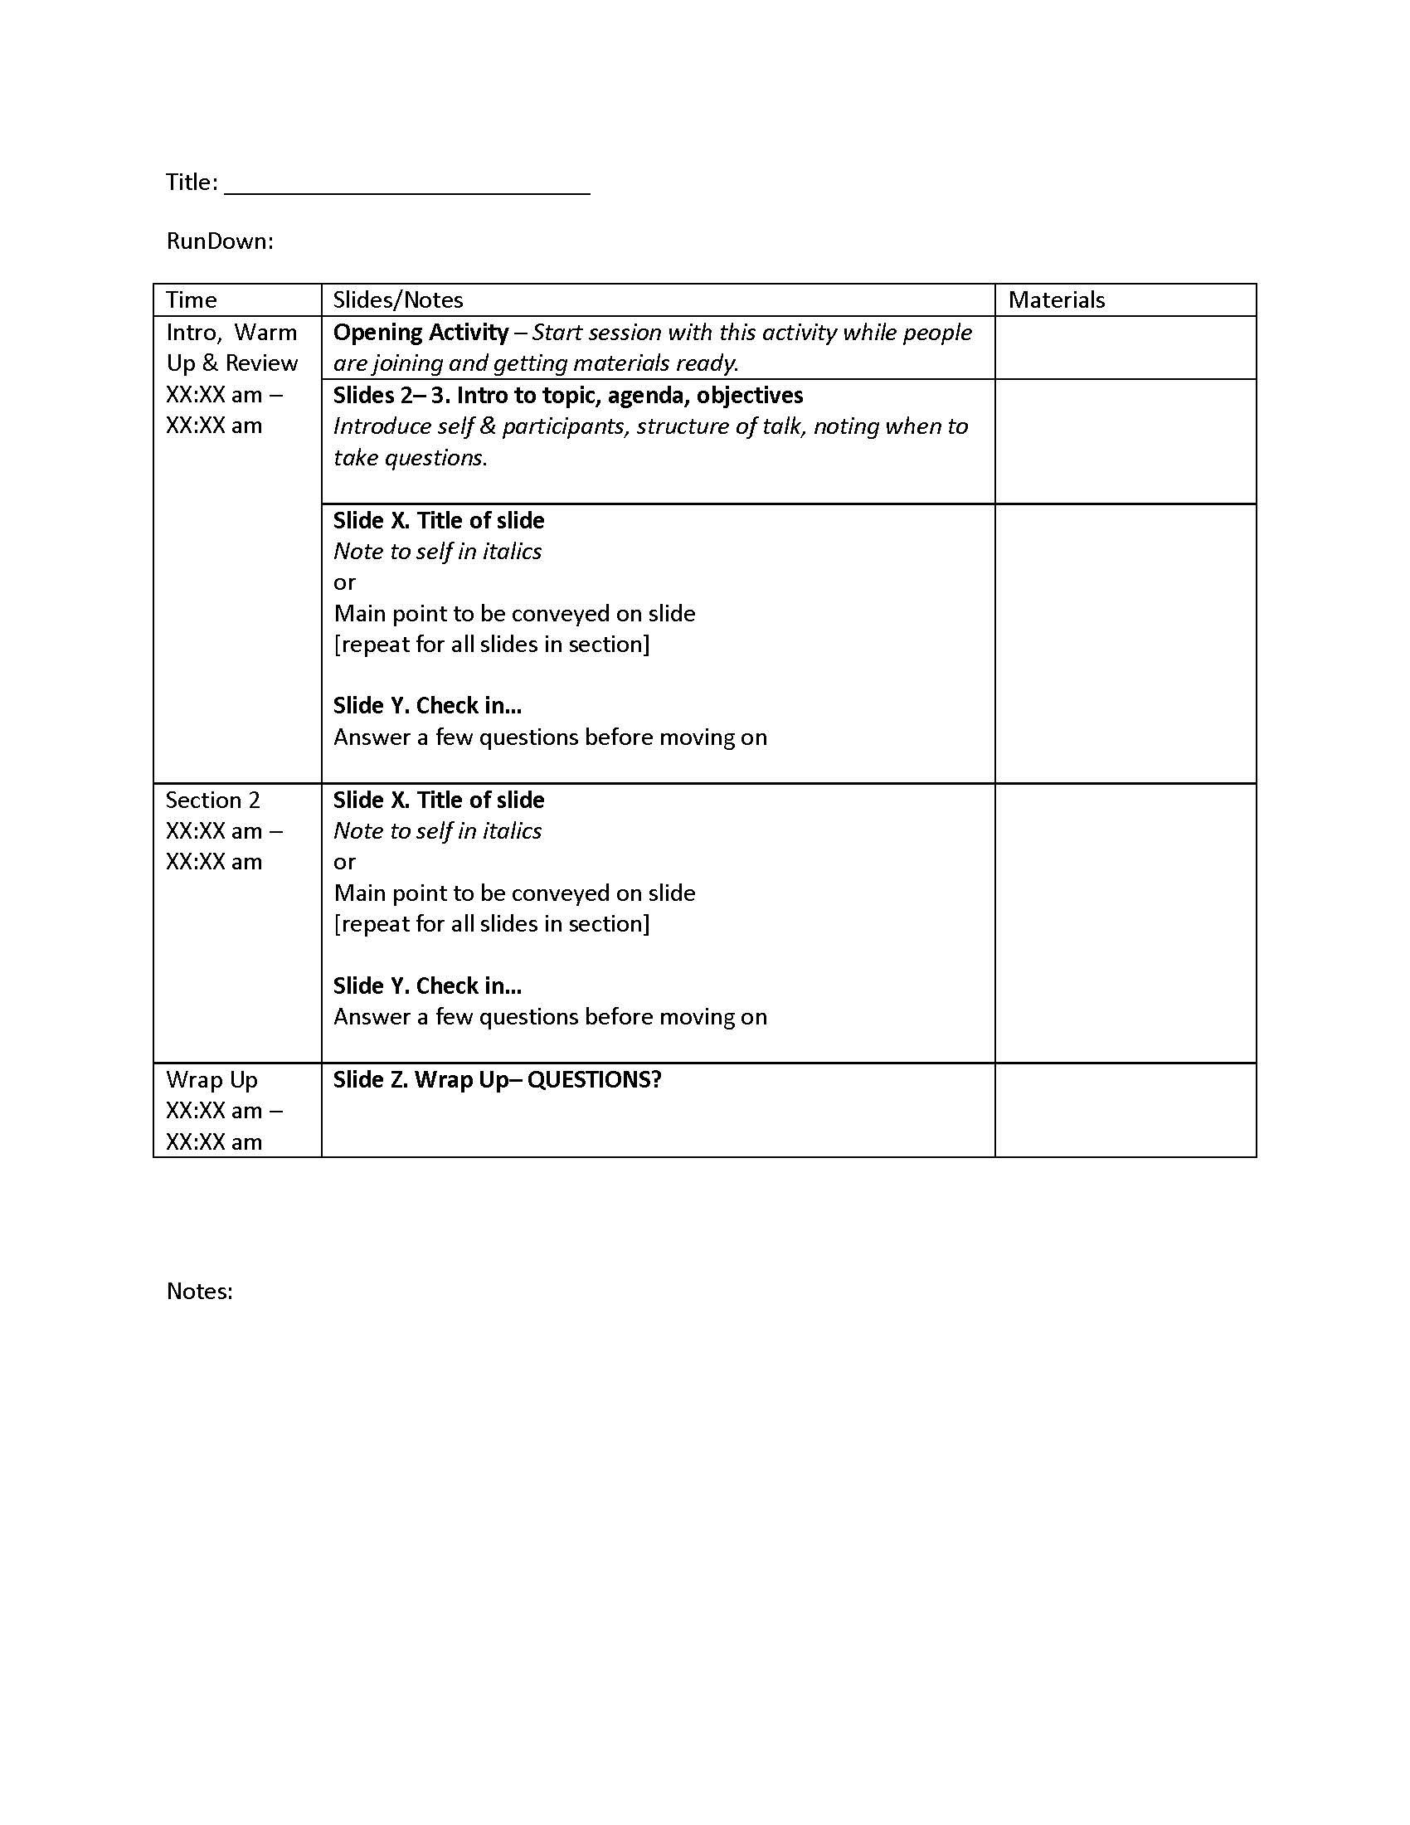
Notes:
Kathy McKnight, a well-known AEA presenter, prepares for her talks using what she called a rundown doc. This document spells out the main points to be made in each part of the talk, what relevant slides or materials or other documents need to be open, and importantly what time the section begins and ends. You’ll have practiced the talk many times, so you’ll have a pretty good sense of how long each section needs to be to convey all of your material and still finish on time. Write it down. Keep yourself on track. When you are pausing for a drink of water, check your timing and then speed up a notch or slow down to keep your pace.
Kathy’s own rundown doc and a blank one you can modify for yourself are both available on the p2i website.
Another part of pacing is keeping the audience in time with you.
The audience can read faster than you can speak. When we present slides like this:

Slide 14
Rhetoric Literature Review
Article highlights the lack of in-depth studies on rhetoric.
Author calls for research-based frameworks that make rhetorical principles easy to apply in work settings.
Frameworks must account for influences such as politics, culture and economics.
rhetorical studies usually focus on persuasive speeches affecting the public;
efforts within his field bear much potential to contribute to public good.
Commentary models a frame of mind that embraces rhetoric, even within a discipline that may not have a history of stressing this skill.
Cyphert, D. (2010). The rhetorical analysis of business speech. Journal of Business Communication, 47(3), 346-368.
Notes:
We put the audience in a position of listening and reading at the same time, which zaps their mental abilities and makes it such that they actually don’t retain any information very well.
So here are two slide tricks you can use as a part of your delivery to match your audience to your pace. The first one is called the slow reveal.

Slide 15
On Rhetoric
Article highlights the lack of in-depth studies on rhetoric.
Author calls for research-based frameworks that make rhetorical principles easy to apply in work settings.
Frameworks must account for influences such as politics, culture and economics.
Commentary models a frame of mind that embraces rhetoric, even within a discipline that may not have a history of stressing this skill.
Notes:
You start with a slightly simplified slide, albeit one with a lot of text still on it. That slide has 4 bullets plus 1 title, so I'll duplicate it such that I end up with five slides that look the same.

Slide 16
On Rhetoric
Article highlights the lack of in-depth studies on rhetoric.
Author calls for research-based frameworks that make rhetorical principles easy to apply in work settings.
Frameworks must account for influences such as politics, culture and economics.
Notes:
Then, just delete one item from each slide, working backward:
This way, when I start at the beginning and work through the slide deck, I'm presenting just one point at a time. This lets my audience focus on what I'm saying (instead of reading ahead and not fully paying attention).

Slide 17
On Rhetoric
Article highlights the lack of in-depth studies on rhetoric.
Author calls for research-based frameworks that make rhetorical principles easy to apply in work settings.
Notes:
Then, just delete one item from each slide, working backward:
This way, when I start at the beginning and work through the slide deck, I'm presenting just one point at a time. This lets my audience focus on what I'm saying (instead of reading ahead and not fully paying attention).
Of course, we could modify other things about this slide to make it more appealing, but even just showing one bullet point at a time helps the audience stay glued.
So ultimately, I end up with five times the number of slides. But don't let that scare you. It's the exact same amount of content, same number of minutes talking.

Slide 18
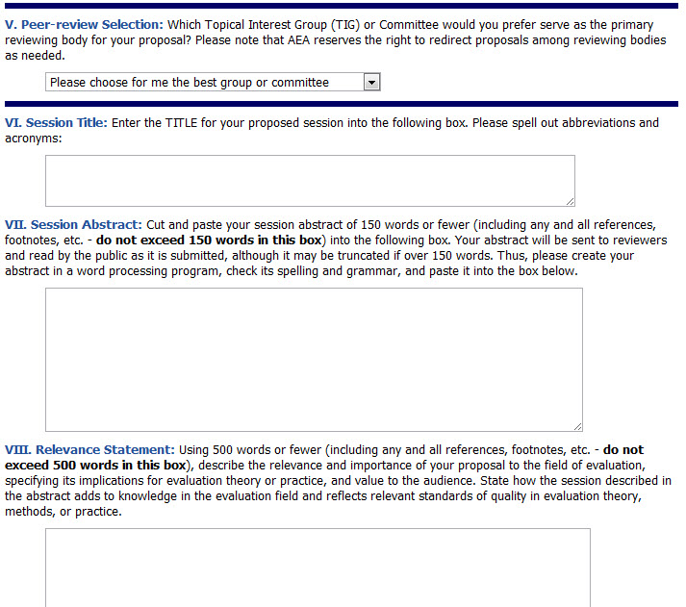
Proposal Submission
Notes:
Another strategy to keep the glue is to selectively highlight and then remove that emphasis.
Here I’m pretending I’m giving an orientation about how to submit a proposal to AEA’s annual conference.

Slide 19
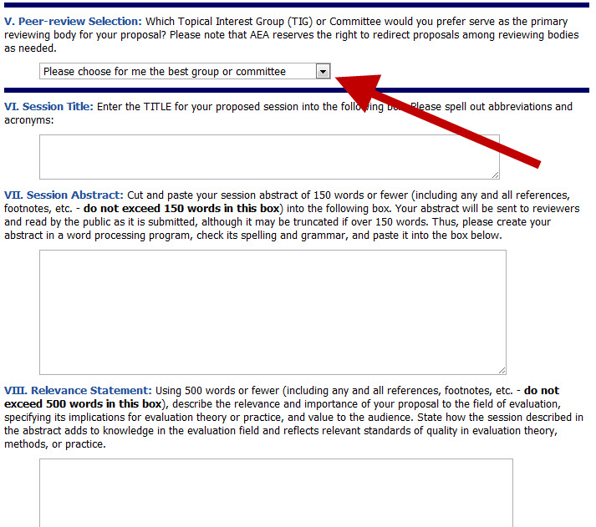
Pick a TIG
Notes:
We keep the same screenshot but we add and move the emphasis via arrows

Slide 20
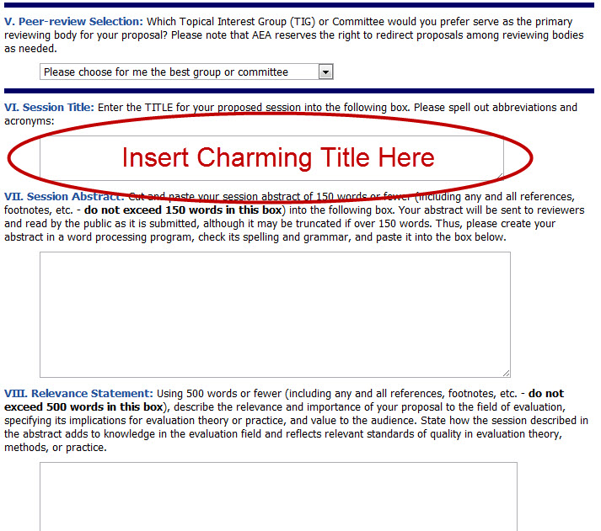
Enter Title
Notes:
and circles to walk people through the process

Slide 21
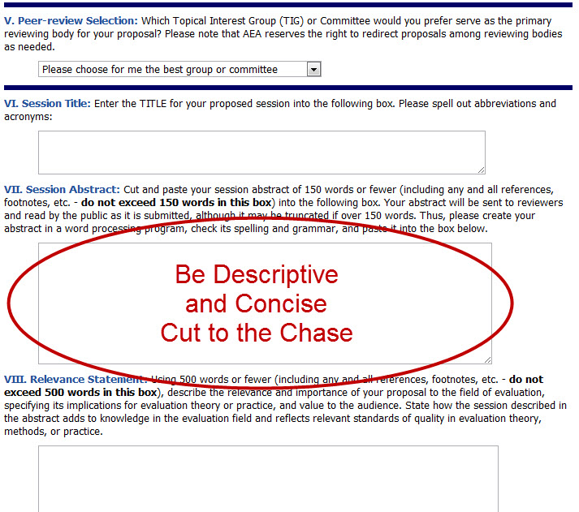
Write Abstract
Notes:
While keeping their attention focused on where I’m talking.
So another strategy is explicit, moving emphasis for simplifying the complex illustrations that we often encounter in evaluation. You can use this to discuss logic models or process charts, anything like that.
Here’s another suggestion for pacing that came through your suggestions.

Slide 22
The presenter takes the audience on an engaging tour of the “map” that is on the screen.
Notes:
“Sometimes when the exact numbers aren’t that important, statistical charts can be presented without numbers but using the color scheme and relative sizes and positions of chart elements to get the meaning across more easily. When doing this, the presenter takes the audience on an engaging tour of the ‘map’ that is on the screen, pointing out the various relationships among the elements and how to interpret them.”

Slide 23
Project Timeline
Think tank feedback at annual conference
Report draft commenced
11/4/11
9/4/12
New analysis plan devised
Presentation drafted
12/7/11
10/4/12
Analysis plan modified
Presentation delivered for further feedback
12/14/11
10/25/12
' 11
Oct 2011
Dec
Feb 2012
Apr
Jun
Aug
Oct
' 12
Feedback period
10/15/11
11/15/11
Analysis period
11/15/11
8/30/12
Reporting period
9/1/12
10/15/12
Feedback period 2
10/15/12
11/15/12
Made with Office Timeline 2010
www.officetimeline.com
Notes:
So that instead of a lot of visual clutter that adds distracting to your talk,

Slide 24
Project Timeline
AEA 2012!
Analysis
AEA 2011
Reporting
Notes:
You present this, where the audience’s attention is kept on you, as the speaker.
So there we have several methods for working with your slide content during delivery to help keep the audience glued to you.

Slide 25
Personal
Notes:
Now let’s turn to the third P, the personal touch. The idea here is that we can increase our engagement with the audience by sprinkling in some informal, interpersonal (and yet possibly scripted) points.

Slide 26
Point 1
Point 2
Point 3
Notes:
The empirical research does speak to this point of delivery. When we break from what appears to be the formal talk track to say things like “This third point here is the most critical” or “my favorite” we peak audience interest and actually boost learning. It’s a bit informal, but you can plan ahead to sprinkle in a few personal touches like that.
The research has shown that adding in personal touches can be particularly effective in conference settings where you are trying to persuade a somewhat skeptical audience. The audiences at AEA are never skeptical, but outside of here you might find that personal touch to be helpful in disarming an audience predisposed to be defensive or tense, like with certain groups of unhappy stakeholders. Rowley-Jolivet & Carter-Thomas, 2005

Slide 27
My hot tips include engaging your audience by using a touch of humor.
Notes:
Another aspect of the personal touch is the role of humor. Whether or not to insert jokes is largely up to your own comfort with being funny in front of a crowd. The Dynamic Dozen were somewhat split on this issue. Some were naturally funny people, so they planned scripted lightheartedness.

Slide 28
Notes:
Others aren’t as comfortable with humor and found that, when they tried it, it totally flopped and became that unwanted distraction. This screenshot and others I’ll show in the rest of this talk come from the very funny satire video, Every Presentation Ever, where the presenter essentially makes every possible delivery mistake. Here is just told a joke that flopped.
So don’t force it if it doesn’t already come naturally for you.
However, the research on the role of humor has shown that funny anecdotes and such create an emotional connection with the audience that can increase the recall of information. (Dolcos, F., LaBar, K.S., & Cabeza, R. (2004). Interaction between the Amygdala and the Medial Temporal Lobe memory system predicts better memory for emotional events. Neuron, 42, 855-863.)
It also encourages openness and defuses threats to competence and likeability (Politi, P. (2009). One-sided laughter in academic presentations: a small-scale investigation. Discourse Studies, 11(5), 561-584.)
Let’s turn to the last P.

Slide 29
Pose
Notes:
Pose – this is about bodies – your’s and your audience’s. Let’s start with yours. When you already have your mind full of your talking points, it can be hard to also think about what your body is doing, but your poise and pose make a big difference.

Slide 30
Notes:
The most basic rule most often broken is when the presenter turns away from the audience, toward the screen, to read the text off of the slide. It is the opposite of what your audience needs in order to hear you.
As obvious as it sounds, this rule is broken all of the time, especially when we’re upping our game and explaining diagrams on the slide. When I absolutely need to be facing the slide, I intentionally talk much louder so I can still be heard.

Slide 31
Get out from behind the podium.
Notes:
Our Dynamic Dozen suggested getting away from the crutch of the podium and moving around the room. It makes you more interesting and give you another way to connect with the audience more.
When you are standing, it’s a good idea to move around. But this isn’t always possible, as you could be in a presentation situation where the room or the format doesn’t allow for it. If you are stuck to the podium microphone, rather than having a lavaliere, for example, there’s not much you can do. Now, that’s an obvious example, but the question of whether to sit or stand up and move isn’t always so clear. Let’s explore that a bit.

Slide 32
?
Notes:
This is the format for a typical think tank. A small group, where you lead the discussion but others are expected to talk a lot. [ASK THE AUDIENCE] Sit or stand?

Slide 33
?
Notes:
A panel discussion, where the panelists have spots at a table. [ASK THE AUDIENCE] Sit or stand?

Slide 34
?
Notes:
A longer demonstration or skill-building session. [ASK THE AUDIENCE] Sit or stand?
Generally, standing and moving tends to be more formal and convey more authority. Smaller working groups or discussion-based forums may call for sitting. So you see, the context matters.
So that’s your body, let’s talk about the bodies of your audiences.

Slide 35
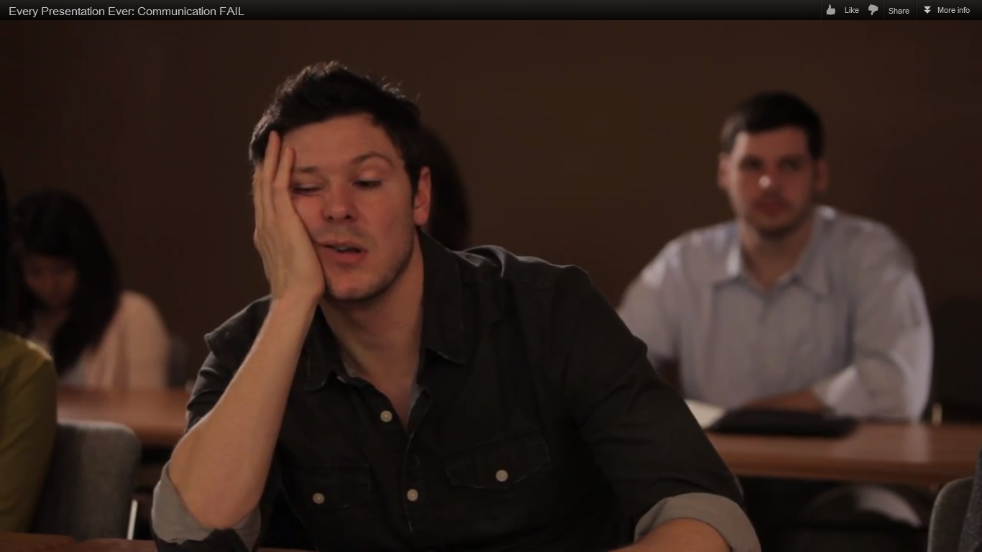
Notes:
The Dynamic Dozen impressed the importance of reading the body language of your audience.
If they’re interested, they’ll be looking at you, taking notes, nodding heads, or even furrowing a brow.
If they’ve checked out, you’ll see phones whip out. Some folks say they’re taking notes on their phones or Googling you or something like that – so in the conference context the number one sign you’ve lost them is when they get out their programs and start looking for another session.
[ASK THE AUDIENCE] When that happens, what can you do? [Take ideas.] All great ideas. Our Dynamic Dozen suggested you initiate an activity, though that takes some skill and the right context. I suggest you take your next point you want to make and turn it into a question and solicit some input. Get them talking and engaged.
And this takes us right into our first A -

Slide 36
Audience
Notes:
Audience management. This has to happen before and throughout your presentation. The goal in audience management is to increase their connection to your content. This is the glue.
Before the presentation starts, or very near its beginning, you want to intentionally connect.

Slide 37
Find out what they know.
Notes:
The Dynamic Dozen suggested you try to find out what they know about your topic. They said they milled around the room as people came in and engaged them in conversation. They also planned activities right at the start that got the audience members sharing their knowledge on the topic. This serves several purposes: it gets them physically moving and engaged, it increases the relevance of the talk to them, and it let’s you know how much they know so that you can better pitch your material to their level.

Slide 38
Adjust difficulty of content.
Notes:
Now, on that last point, the Dynamic Dozen said they’ll rework their content on the spot, once they find out what the audience knows. This takes a great deal of skill. After all, you’ve prepared precisely timed content that this suggestion would throw off.
But some have observed that less skilled audiences need more concrete examples and more skilled audiences like to hear and exchange stories or case studies with one another. So you might decide on the spot to replace your preplanned concrete examples and open the floor for discussion if you find they are an advanced group.

Slide 39
Insert activities
Notes:
Regardless of the skill level, you’ll want to intersperse breaks, whether they be to take questions, or to engage in an activity. The research on public speaking shows that in classroom settings, longer bouts of talking, like I’m doing now, will decrease learning and increase mind-wandering. That’s an unwanted distraction. So break content into sections and take questions or launch an activity. The Dynamic Dozen suggested an activity every 15-20 minutes for longer talks. Even in a short paper presentation, you can probably build in a quick show of hands or something like that.

Slide 40
30 sec answers
Notes:
So let’s talk a little bit about Q&A breaks and how to manage those.
The first rule is, try to limit your answers to under 30 seconds. You can usually assume that if one person asks the question, others in the room will have the same question in their minds, so you do want to address it as completely as possible, but audience Q&A is one of the primary “check your iPhone” points, so keep it moving quickly.
But that’s when you have a concise answer. What about when you don’t know the answer? Handling that poorly is an unwanted distraction.

Slide 41
Get comfortable with I Don’t Know.
Notes:
The Dynamic Dozen said you should be okay with saying I don’t know. But turn it right around and say what do you think? Sometimes, when the audience member is asking out of hostility or even one-upmanship, they really just want the floor for a moment to show how smart they are. Give it to them. And then say thanks. If the audience member genuinely doesn’t know or have any suggestions, ask the room for input and get to some answers together.
In situations where absolutely no one knows, say you’ll look into it and then contact the group later with the answer.
These responses maintain your leadership in the room and keep the glue on you.

Slide 42
All Hell Breaks Loose
Notes:
The Final A – if All Hell Breaks Loose.
Despite our best preparations and our avoidance of unwanted distractions, sometimes they still happen. Everybody’s got a story about this. The project bulb breaks. The ceiling tile falls to the ground. What do you do?

Slide 43
Move to an activity.
Notes:
One of our Dynamic Dozen told of a story where he was beginning to speak just as the cleaning crew came into the room and started removing dishes, clanking glasses, making a bunch of noise and distraction. Instead of trying to compete with that, he launched a small group activity and had them work together for a few minutes. Now that’s skill. But it’s a back up idea to add to your list.

Slide 44
Notes:
Another common situation is where the program you need won’t open. If you plan to demonstrate a software program or a website or anything besides a slidedeck, take screenshots as a back up plan.

Slide 45
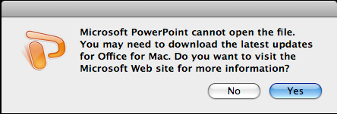
Notes:
If the whole computer shuts down or the projector quits working, forget the slides and just talk through the points you can and rely on audience discussion. This is why you’ve prepared written notes and committed your first and last 5 minutes to memory. You can usually get by without slides if needed. Again, promise to send out the slides or visuals later on.
[ASK THE AUDIENCE] What else? Who else can describe the horror story and the solution in about 15 seconds?
So the problems can by numerous, but you just go with the flow, remain poised, and work with it. How you handle the problem reflects your leadership, your credibility, and your management.

Slide 46
4P & 2A
Prep
Audience
Pace
All Hell
Personal
Pose
Notes:
That was the 4P and 2A’s of Delivery Glue. Let’s take questions for a few minutes.

Slide 47
p2i.eval.org
YOUR EMAIL
Notes:
[ADD YOUR CONTACT INFO TO THIS SLIDE]
On your handout you’ll see a few resources if you are interested in learning more, including AEA’s report from their interviews with the Dynamic Dozen.
Don’t forget to check the p2i website where materials on Message, Design, and Delivery are available.
Best of luck on your presentations!

