Slide 1


Notes:
[This work by American Evaluation Association is licensed under a Creative Commons Attribution-NonCommercial-ShareAlike 3.0 Unported License. Based on a work at http://p2i.eval.org/.]
[THIS PRESENTATION IS DESIGNED TO LAST ABOUT 90 MINUTES. YOU SHOULD CUSTOMIZE IT TO YOUR OWN SITUATION PRIOR TO PRESENTING, PARTICULARLY ADJUSTING THE LAST SLIDES RELATED TO A CALL TO ACTION. THE SCRIPT HERE IS ONLY A SUGGESTION. BRACKETED, ALL CAPS WORDS ARE NOTES TO THE SPEAKER, NOT TO BE READ ALOUD]
Welcome. We’re here today to talk about how to [CLICK] craft your presentation message. We’re aiming specifically for the conference presentations so that you all have fantastic experiences as presenters and audience members, but we’re also hoping you’ll carry these ideas over into the presenting you do as part of your regular evaluation dissemination. I’m going to lead you through what research says about structuring a great presentation, what our top AEA presenters do, and what you said you needed as an audience.

Slide 2


Notes:
Research that distinguishes good from weak presentations basically says we have two ways of hearing an appeal.
Through rational appraisal – that is, an appeal to logic, to the mind,
[CLICK]
Or through experiential response – which relates to emotions, the heart (and sometimes other areas of the body we can’t talk about today)
Traditionally, as academically-trained evaluators who have to sometimes be presenters, we’ve tended to think that we’ll only be taken seriously if we speak to the brain and that doing so makes us rigorous, scientific, and credible. It seems soft to tap into an emotion.
The problem is that presenting information in that way doesn’t actually do much for our brains. It might feel logical – but because it doesn’t tap into an emotion, it doesn’t get remembered, retained, recalled. And that’s really why we’re here, presenting to one another. To teach and to learn. But to reach that goal, we have to craft a message that speaks to both our logic and our emotion. It’s that planning and crafting of a message that we’ll talk about today.

Slide 3

Notes:
But how does one construct that logic and emotional message in the length of a typical conference presentation (roughly 15 minutes)?
[ASK THE AUDIENCE] Who has about 15 minutes? And who has longer?
The basic structure we’ll talk about today is designed for the 15 minute paper, but can be expanded or contracted based on your time frame and can be used for your presentations outside of this conference, of course.

Slide 4
Background
Literature Review
Methodology
Discussion
Findings
Conclusions
Flip
the Report
Notes:
Let’s look at how we normally go about structuring our presentations. This is the part that feels serious and logical and rigorous. Does it look familiar? Yes, it’s the basic format for a journal article. It’s just that a journal article is not the same dissemination forum as a presentation. Jane Davidson has been talking for some time about more actionable reporting, in which we do not make the reader wait until page 50 to get to the good stuff. Today’s readers just don’t have the patience for it.
In a very similar vein, if we bore people with 5 minutes of the background and literature review and methodology before we get to the interesting stuff in a conference presentation, [ASK THE AUDIENCE] what will they do? Check their phone, sleep, leave.
So for a conference presentation, we are, in essence, going to [CLICK] Flip the report.

Slide 5
Background
Literature Review
Methodology
Discussion
Findings
Conclusions
Background
Notes:
What one would normally write in the background and methodology sections will be collapsed and condensed into the presentation background.

Slide 6
Background
Literature Review
Methodology
Discussion
Findings
Conclusions
Background
Conclusions
(Bottom Line)
Notes:
Things we would say in the Findings and Conclusions of a paper will be summarized and condensed and given straight away, in what we will re-term the “bottom line.” This way, we are giving value and information quickly. We’re saying – “here is the brunt of my message”

Slide 7
Background
Literature Review
Methodology
Discussion
Findings
Conclusions
Background
Bottom Line
Discussion (Explanation)
Notes:
We’ll move up the discussion, because now, instead of building up our case, we’re explaining the bottom line we’ve just conveyed. And we’ll call that the Explanation.

Slide 8
Background
Literature Review
Methodology
Discussion
Findings
Conclusions
Background
Bottom Line
Explanation
Literature Review
(So What)
Notes:
The literature review, where we ground our work in the field and make clear our position in relation to other thinkers, comes next. We basically relate our work out to the audience. So we’ll call it the So What section.

Slide 9
Background
Literature Review
Methodology
Discussion
Findings
Conclusions
Background
Bottom Line
Explanation
So What
Call to Action
Notes:
Finally, we’ll add a new piece that doesn’t often show up in journal articles – the call to action. We will talk about each of these in much more detail. But let’s first be clear how much time we should plan to spend in each of these areas.

Slide 10

5% Background
20% Bottom Line
Messaging Model
50% Explanation
15% So What
10% Call to Action
Notes:
In the Messaging Model, we do not give equal time to each part of a presentation. When we are planning our content and our message, we redistribute the time allocation. You can see that in this model, we distill the background down to just 5% of the presentation, so that we can jump right in to the main message and the heart of the content. We list it in percentages here so that you can readjust the timing to match your own presentations, whether longer than 15 minutes or outside of the conferencing platform.
[Distribute handout.]
This handout shows the messaging model and leaves space for your own notes. As we walk through the components of the model, you can fill in the details on your handout and walk out of here with a more solidified message.

Slide 11
5% Background
0:45
0:00
20% Bottom Line
3:45
50% Explanation
11:15
15% So What
13:30
10% Call to Action
15:00
Notes:
When we apply the Messaging Model to a 15 minute conference presentation slot, here is how the timing works out.
We spend about 45 seconds on the background
3 minutes on the bottom line
About 7.5 minutes on the explanation
Another 2 minutes and 15 seconds on the so what
And the last minute and a half on the call to action.
Now you may have heard that AEA interviewed a dozen of their top presenters recently. AEA pulled together the findings into three reports, which are listed on your handout. They had a lot to say about crafting a message and one of them gave a very helpful concrete tip: To intersperse activity every 10-20 minutes. That means you should plan a little something, even if its just a quick show of hands. You could do so in the Background and So What sections, or insert something small in the Explanation, or whatever fits with your content. But even in the short span of 15 minutes, plan for some activity, something to keep the audience physically engaged.
So from here we will break down each of these areas for further explanation.

Slide 12
Tell the story
of a program,
creating emotional connections.
Notes:
But let’s start out by considering an excellent suggestion like this one, that came from an AEA member. AEA asked what you though made a presentation potent, and here is one of the responses we got. “Great reports & presentations tell the story of a program, creating emotional connections between ideas & explaining findings in a way that the audience can use.” That IS where we are headed and not just at AEA. Much of the world of presentation designers has been caught up with the notion of connecting the head and the heart (for good reason) and often that has resulted in the same sentiment – tell a story. Except that in the presentation world it’s come to be literal. They have been saying you should literally turn your presentation into a storytelling exercise.
And putting that into practice has been a tedious process for many. After all, we are evaluators. We are not professional speakers. And often, our data doesn’t fit into a nice plot line.

Slide 13
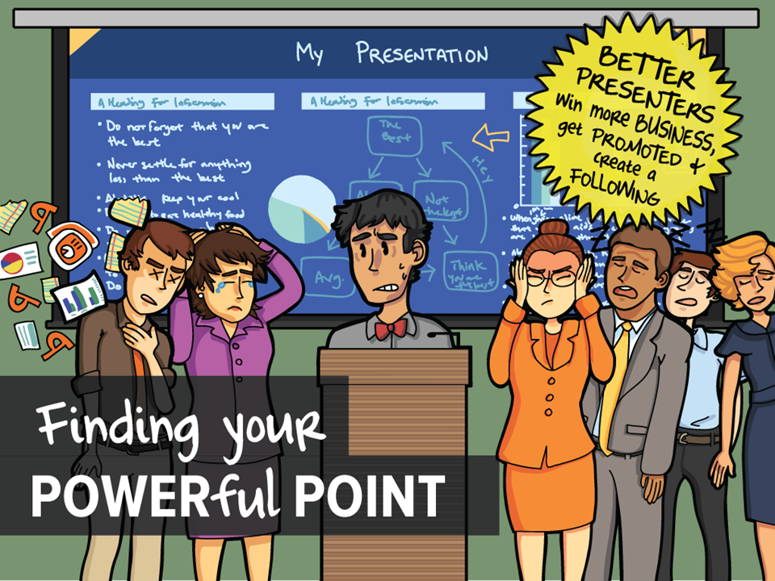
Notes:
That is where we can turn to the work of Gavin McMahon, from FassForward Consulting. He gave a webinar called Finding your POWERful POINT.
Gavin works as a change management consultant. In his line of work, he deals with a lot of people, who are not primarily hired to be professional speakers. He outlines 6 different types of presenters. These are Gavin’s slides. As we go through think about which type fits you. Each one will craft their message a bit differently.

Slide 14
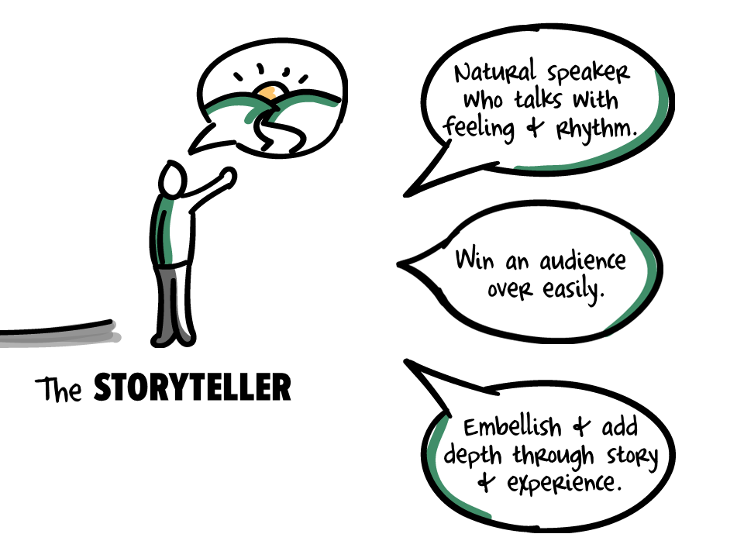
Notes:
The StoryTeller.
If you are a storyteller, you’re a natural speaker who talks with feeling and rhythm. It seems like you can do 5 minutes on any subject. You can win an audience over easily. You use powerful and emotive words typically speaking about what needs to get done and you will embellish and add depth and detail through story and experience.
It’s a great gift. These are one of the types that people typically look to and wish they could be like that. Gavin said these are usually the folks who got on stage when they were in high school and never really got off.

Slide 15
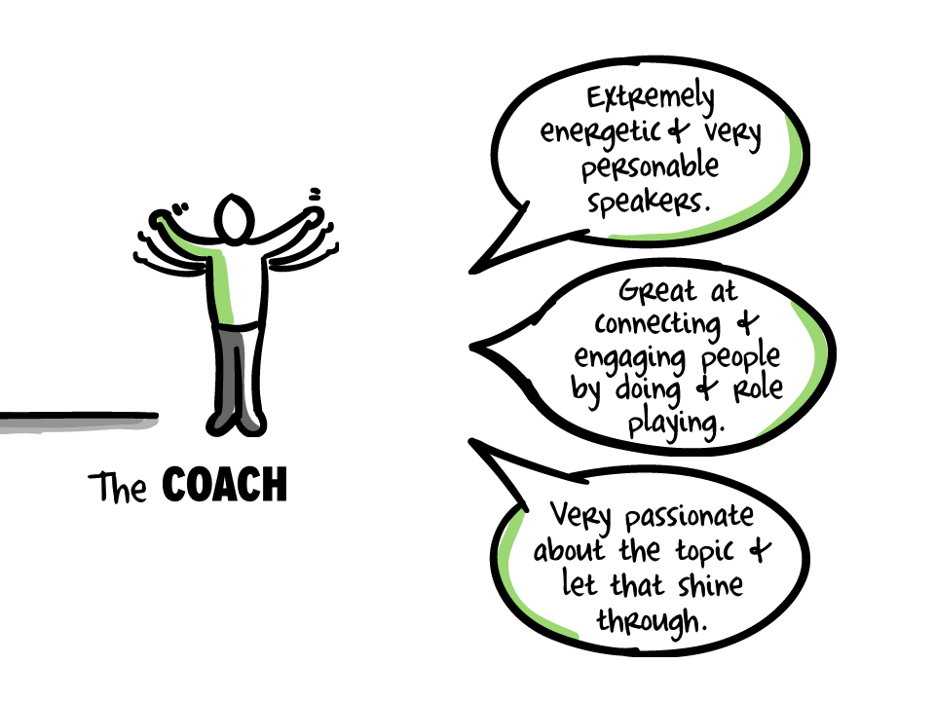
Notes:
The second type of presenter is the Coach. Like Storytellers, you often see Coaches in very senior Leadership positions, because they are naturally good communicators.
As you might guess, Coaches are extremely energetic. They are very personable speakers. Live, they’re great at connecting and engaging people by doing and role playing. They can quickly lose passion and enthusiasm with a low energy audience. They’re usually very passionate about the topic and let that shine through.

Slide 16
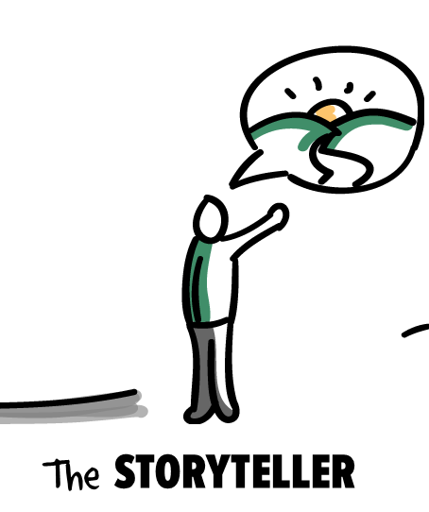
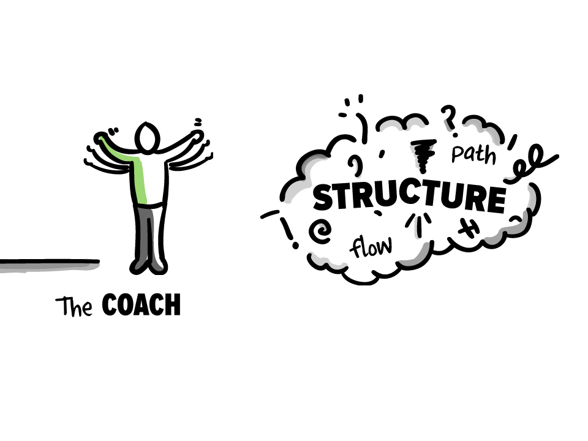
Notes:
Storytellers and coaches tend to be fun people to listen to, They don’t need notes…
But often times, the audience can walk away from the presentation without being able to list off three things they learned. These two types tell great stories and do a wonderful job connecting with our emotions, but they tend to lack some of the logical structure we need to appeal to the head.

Slide 17
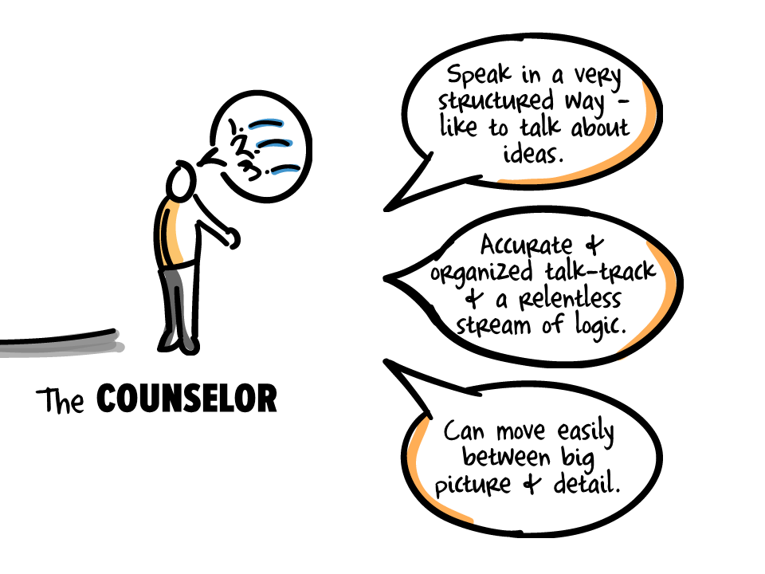
Notes:
The third type of presenter is the Counselor. They don’t have a problem with STRUCTURE. In fact they speak in a very structured way. They can always give a very rational well thought out and structured argument or response, sounding like they are reading from a textbook.
This ability to speak to structure makes Counselors very eloquent speakers who likes to talk about ideas. They have an accurate and organized talk track, and a relentless stream of logic that’s easy to follow. This skill allows Counselor to make the same presentation to an empty room as a large audience. Their dress rehearsal will be the same as the live show. HOWEVER Because they’re more engaged with the content than the audience, they can fail to connect.

Slide 18
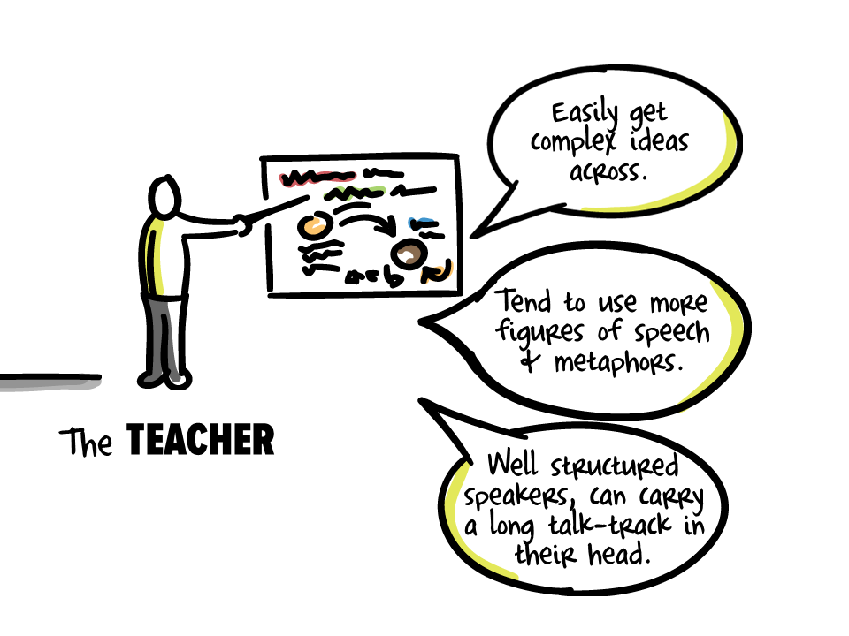
Notes:
The 4th presenter type are Teachers. Like Counselors, they can easily get complex ideas across. Teachers tend to use more figures of speech and metaphors. They are well structured speakers, with the ability to carry a long talk-track in their head.

Slide 19
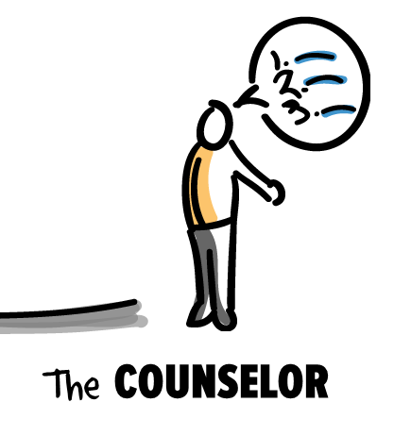
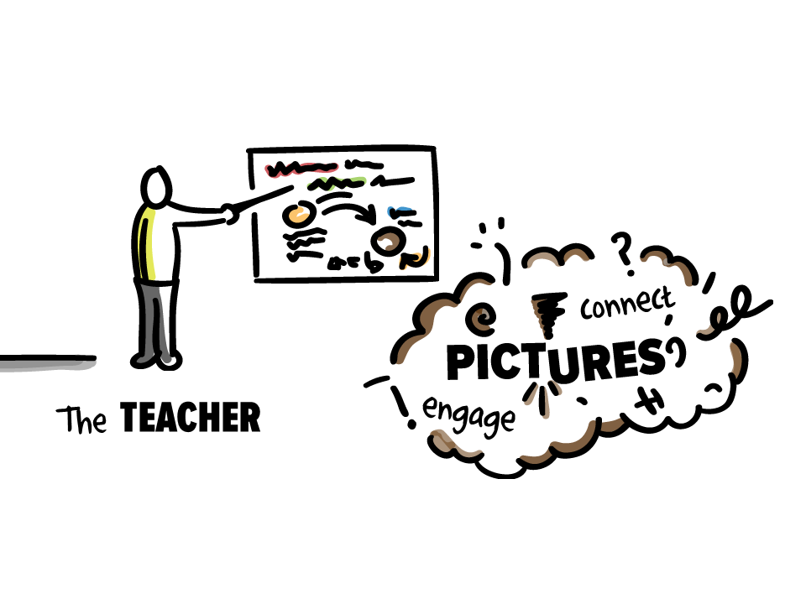
Notes:
Teachers and Counselors tend to put the importance of the material over interaction and engagement with the audience. Because of that they can inadvertently disconnect, miss non-verbal cues and become more distant. Sometimes the visuals they use are overly complex. Simple for them to understand, looks like a wiring diagram - difficult for the audience to grasp. The presentation will tend to more technical than emotional, more cerebral than smart. You won’t often hear personal stories or experience from a Counselor. Rather than use metaphor to illustrate they’ll provide a dry, clinical description.
Both of these types need to tap more in to an emotional connection to the audience. Kicking off the presentation with a question is a good idea.
This comes in lots of flavors, one of which is telling a small story or a metaphor. Or including more Q & A or activities.

Slide 20
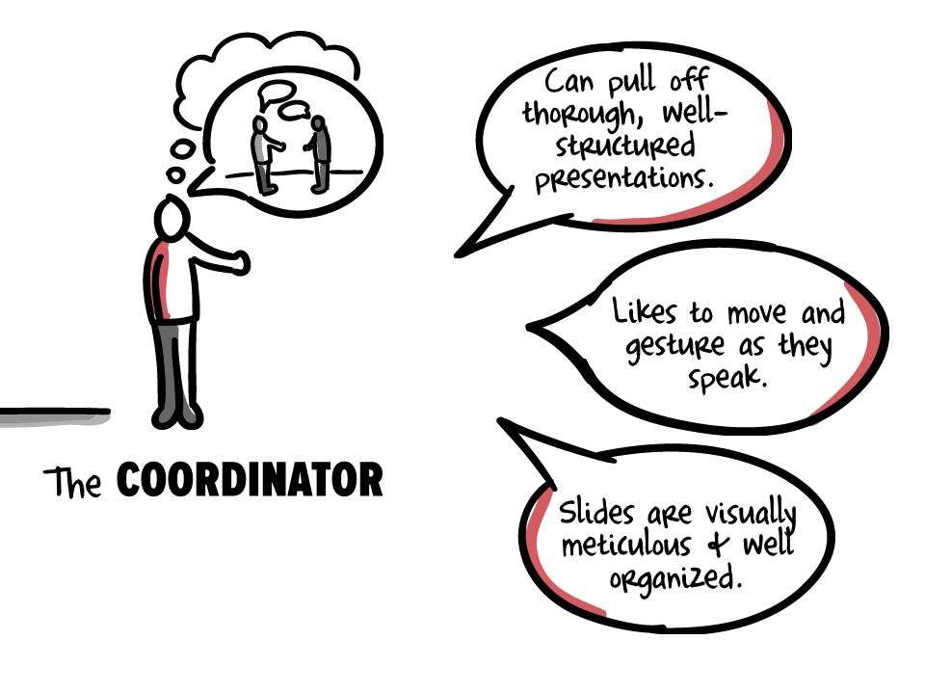
Notes:
If they have to, a Coordinator will give organized, well structured presentations. They naturally prefer to be the audience rather than the presenter, but can pull off a well-organized, well-structured presentations, moving and gesturing as they speak. That rule from presentation class about standing still and not fidgeting, look up and make eye contact is difficult for them. Their slides are visually meticulous and well organized, and when they work well trigger a well thought out talk-track.

Slide 21
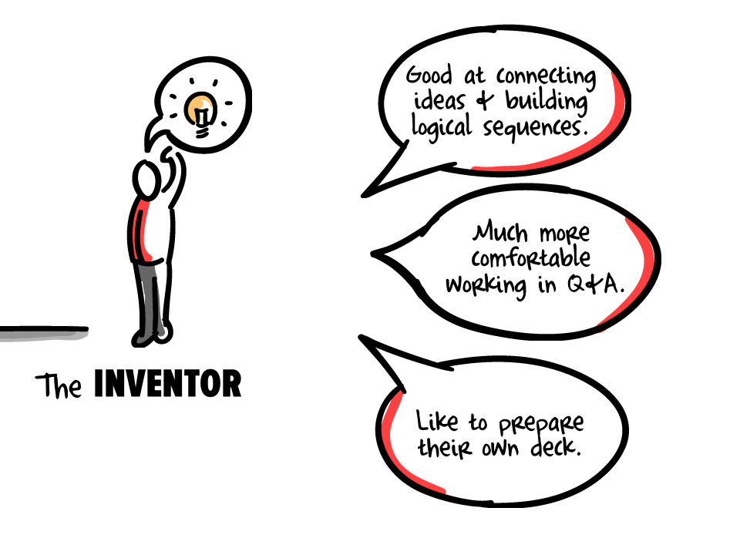
Notes:
Inventors are completely logical thinkers but aren’t natural presenters. They’re more comfortable discussing their ideas in somewhat more informal settings like the Q&A, rather than the formal presentation. These folks are the type who would rework something to make it their own rather than present someone else’s materials.

Slide 22
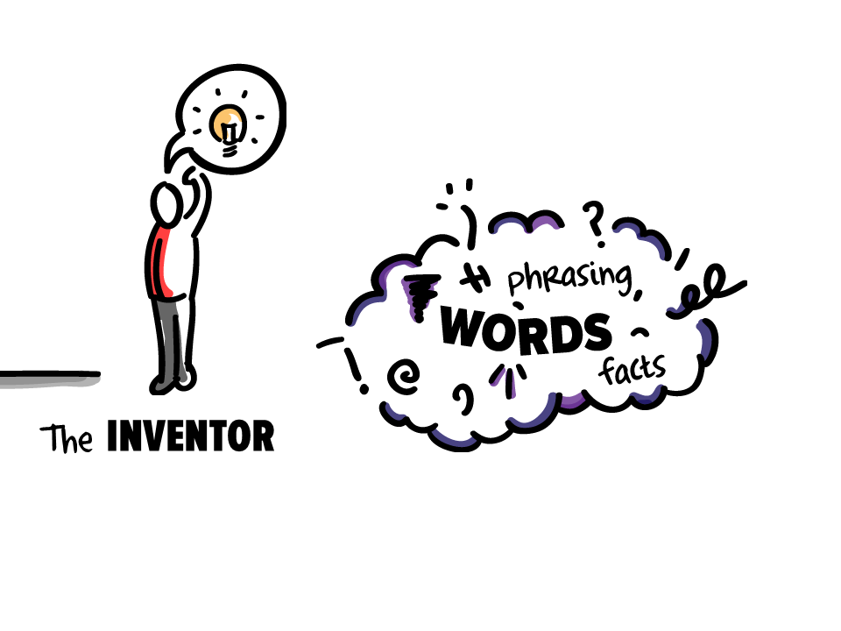
Notes:
The biggest problem for Inventors and Coordinators is that they have difficulty holding a long talk track in their head. They are the types that use slides like a teleprompter. Lots of bullets and words, packed with information. Your classic death by PowerPoint.
They know (and fear) that there’s an eloquent phrase out there, and trying to remember it, or that key fact, or number — trying to remember that — is where it can all go horribly wrong. Because they struggle with WORDS, being put in a position where they have to search for WORDS is a big fear. And that’s how they end up with all of the words on their slides.
For these two types of presenters, it works best if the presentation message is written right on the slides. You should not put all of your words on your slides, but the key message, the pieces that are critical to get right on point, need to be written down for this crowd.
Now, we spent the last 10 minutes thinking about different types of presenters because the rest of this presentation about your message has to be filtered through the type of presenter that you are.

Slide 23

Take the survey (later)
Notes:
I tell you all of this to say that you should find out what works for you. The presentation messaging package that works best for your colleague or the advice given on the latest blog might be excellent in and of itself, it just might not fit your presentation style or your data.
On the handout you will see a link to Gavin’s Presenter Type survey. You can find out what type you are and he’ll give you some advice on how to design and deliver your talk so it fits with your style. Be warned, the survey can’t be taken on a mobile device. So do it when you get back to your laptop and a wifi connection.
But do you have a hunch about your type right now? Keep that in mind because it will help you figure out what to say in each piece of the Messaging Model. Let’s turn back to that now.

Slide 24
0:45
5% Background
Notes:
We begin with – at most – 45 seconds laying the groundwork of the talk. This is when you introduce yourself, perhaps where you work if that helps establish your credibility, perhaps – if you must – who funded you. Spend no more than 45 seconds on this. No offense, but the specific details of the program and evaluation history aren’t the most important parts of the talk.
Frankly, this is usually the part of the talk that is least interesting, so we want to move through it quickly.
We set the tone here for how the rest of the talk will go. Do spend this time introducing the audience to the characters that will appear in the rest of the story. If they don’t appear later on, don’t mention it here.
Now, truly great speeches typically do not start with this kind of warm up. Remember in high school composition class we learned about the strong opening sentence? Truly great speeches tend to begin with a firework, not a tribute to NSF. However, truly great speeches usually have someone else introducing the truly great speaker. The introduction contains this 45 seconds of background, leaving the speaker to move straight to the bottom line. If you have someone introducing you, you can probably skip this introduction and redistribute this bit of time elsewhere. Most of us, though, are up here introducing ourselves.

Slide 25
Failing Fast with
Focus Groups
Your Name
Your organization
Notes:
So I might spend this time on my intro slide, saying “Thank you for coming, let’s begin, I’m so-and-so from this organization and I’m here today to talk to you about what I learned from my bad experiences running focus groups.”
And this might be a great time to gather a little background on your audience as well. [ASK THE AUDIENCE] “How many of you have conducted focus groups sometime in the past two years? Raise your hand. Now keep your hand up if at least once your focus group has gone wrong, not given you the data you needed or become unmanageable. Look around at the collective wisdom here. Share those experiences as we move forward.”
Right, so some kind of background setting activity might be appropriate, where I’m also setting the stage for group interaction. This is especially helpful if you are the type that needs to connect with the audience.
You may also choose to introduce characters, if you’re of the mind to tell a story and use pictures to tap into emotion. So “I’m so-and-so from this organization and I’m here today to talk to you about-

Slide 26

Lydia age 7
Notes:
Lydia. She’s only 7 but she taught me a lot this year about focus groups and now I’m going to tell you.”
So it’s still intriguing, it sets the stage, she draws people in.
But it’s quick and then we move right on.

Slide 27
0:45
5% Background
Notes:
So take moment right now and jot down on your handout the parts you have to state at the start of your presentation and the part of your topic you’ll include in the Background to set the stage. Write it down now. [GIVE 3 MINUTES]

Slide 28
5% Background
3:00
20% Bottom Line
Notes:
Now we’re getting to the content that matters most to people, why they came to your session in the first place. The Bottom Line.
Tell the main message, the finding, the key conclusion of the talk and why this content matters for the audience. We reveal this right away so that the audience doesn’t spend their mental capacity wondering whether this talk is actually going to be relevant to their needs or whether they should politely scoot out.
When AEA’s expert presenters, the Dynamic Dozen, talked about their presentation development strategies, they said they began with an identification of the key points, the bottom line. Then they built the rest of their supporting content to support or illustrate the bottom line. So at this point, we are just making that internal map obvious to the crowd.

Slide 29
Provide a roadmap
of the presentation
at the beginning.
Notes:
You said it - AEA Member Suggestion: “Provide a roadmap of the presentation at the beginning.”
This person went on to say, “The audience will appreciate it if they don’t have to sit through the entire presentation only to find out that you didn’t cover what they thought you will. It also benefits the presenter if they can set correct expectations at the beginning of their presentation.”
We will share that roadmap.

Slide 30
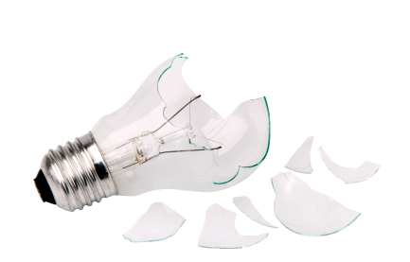
Great Ideas Gone Bad
Notes:
So we might start this section out with something like “I’ve completed 10 focus groups this year and we royally missed the mark. We got the data we needed, but we went about it in the wrong way.”

Slide 31
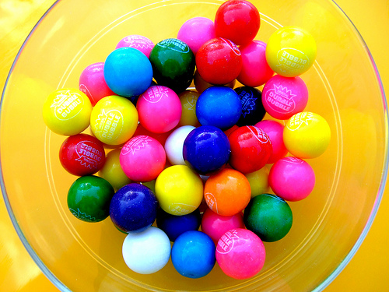
the problem
focus group incentives
Notes:
“You see, we were conducting the focus groups with late elementary-aged girls and we were trying to come up with appropriate incentives for their participation in our somewhat boring questions. Now, don’t get me wrong – the girls LOVED our bubble gum and candy. But guess who did not. Yes, the parents. We should have checked with parents about appropriate incentives before we started our focus group.”
Ok, now, did you just catch the main message of the talk? Here it is again “We should have checked with parents about appropriate incentives before we started our focus group.” That’s the bottom line right there. It is distilled and encapsulated and told at the beginning. Everything else we want to convey builds on and supports this bottom line.
Which means, you must figure out your bottom line and encapsulate it. Let’s practice that right now.

Slide 32

six word
presentation story
Notes:
Some time ago, there was a series of books from SMITH Magaizne that came out called the Six Word Memiors. Famous and not famous people were asked to sum up the totality of what happened in their lives into just six words. Sounds like a challenge, right? Here are some of the best:
After cancer, I became a semicolon.
Anthony R. Cardno
The psychic said I'd be richer.
- Elizabeth Bernstein
Brought it to a boil, often.
- Mario Batali
Now, if they can tell their entire lives in just six words, so to can you funnel your presentation story into the key message. Take a moment right now. But before you get too far, let me warn you about a common mistake: in the effort to summarize, the six words can become the most boring and generic story. So don’t go there. Come up with your six words and then share it with the people around you who can tell you if it’s appropriately enticing. Let’s take 5 minutes right now and write it directly on your handout in your Bottom Line section. [GIVE 5 MINUTES]
[ASK THE AUDIENCE] What did you come up with? Can we share a couple? [Take a few minutes to share.]

Slide 33
Memorable messages are distilled and structured.
Notes:
Here is the six word presentation story for this presentation.
Coordinators and Inventors may very well need to put these 6 words on their slides.
Now I know this seems a bit restrictive. You do not literally have to stick to six words but the idea is that you can concisely convey the key point of your work.

Slide 34
5% Background
3:00
20% Bottom Line
Notes:
So the Bottom Line contains your summarized key point with some slight elaboration and foreshadowing of the next pieces of your talk.

Slide 35
5% Background
20% Bottom Line
50% Explanation
7:00
Notes:
Once we’ve established the Bottom Line, we can elaborate in the Explanation. This is largest chunk of the talk and it follows the exciting high of the Bottom Line so it must keep attention and reinforce the message and you can do so in a way that taps into both logic and emotion.
I’ll walk through some possible ways to organize and structure this part of the Messaging Model. We want to give a logical structure that speaks to our need for organization while also connecting with the audience, through interaction, through our stories, through our humor or whatever fits your presentation type and your data. There are many possible ways to structure the explanation.

Slide 36

Metaphor
Notes:
Metaphor
In the Potent Presentations talk on presentation delivery, they speak about Delivery Glue.
Beth Kanter’s talk on using social media for nonprofits is framed as Crawl, Walk, Run, Swim. So she draws on a progressive model already familiar to the audience to explain concepts they don’t know well at all.

Slide 37


Compare
Contrast
Notes:
You can compare and contrast your content with something else. This can be especially helpful if you are introducing something fairly theoretical or high-level. Defining it by what it like and what it is not can help conceptually consolidate your information.
Similarly, the research in rhetoric shows that great political speeches have used a “my view” / “my opponent’s view” structure that contrasts the speech.

Slide 38
1
“
I have three things to tell you about focus groups.
2
”
3
Notes:
You can summarize it into three (or some number of) key points. This is one of the most basic ways of structuring, and it’s actually a fairly weak structure, but grouping the content into three main chunks helps people remember the content later on because once they recall those three main points, they are better able to fill in the details as well.

Slide 39
“
Can I get a drumroll, please…
”
Top 10 List
Notes:
Then there’s the ubiquitous Top 10 list.
It works best for sequential content, but remember that there are only 7 minutes in this section, so it would have to be content you can walk through quickly.

Slide 40


Pro
Con
Notes:
You could try a pro/con structure. Imagine putting this framework on a discussion about innovative methods. It’s a relatable structure, particularly for evaluators. It is different from compare/contrast in that you don’t necessarily need to have other information to reference or compare to.

Slide 41
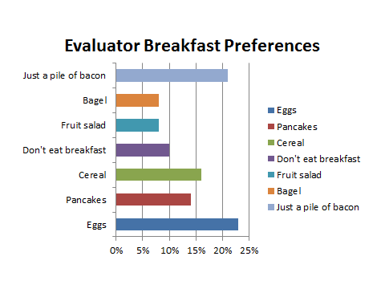
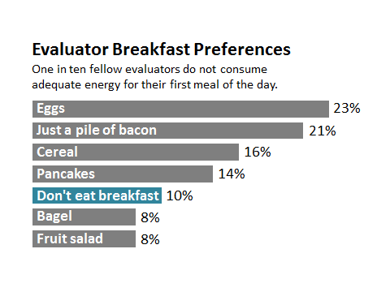
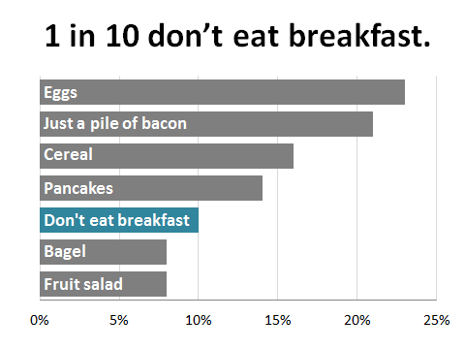
Good
Better
Best
Notes:
Good/better/best could be another organizing structure. AEA uses this in the Potent Presentations training on slide design, where they actually walk through before and after examples. Like the rest of these, it is a relatable way of conveying your information. And it is in that relatability that we connect to our audience’s emotions.

Slide 42

Storyline
“
83% of our
cases are like Lydia’s
”
Notes:
Finally, there’s the popular organizational concept of a story.
If you aren’t a natural storyteller or it doesn’t make sense for your content, you can use one of these earlier structures. But if you think you might like to give storytelling a try, there’s good reason. More and more research is showing that stories connect to the heart and the mind in powerful ways. It’s been found to be particularly excellent for persuasion of those with counter beliefs http://www.thejuryexpert.com/wp-content/uploads/MazzoccoGreenTJEMay2011.pdf
Stories exhibit greater attitude and belief change.
Now within the overarching organizing principle of storytelling, there are lots of ways to actually structure a story.

Slide 43
confrontation
resolution
setup
Aristotle’s 3-part arc
Notes:
This is what Artistotle thought. He divided this up into 3 acts.
Act One sets up the main character's dilemma, and commits them to resolving it.
Act Two develops the underlying conflict between the main character and whatever forces stand between her or him and the resolution.
Act Three resolves the conflict and shows us how the character has changed along the way, often hinting at the character's ultimate destiny.
http://www.musik-therapie.at/PederHill/Structure&Plot.htm

Slide 44
climax
rising action
falling action
exposition
denouement
Freytag’s pyramid
Notes:
Here’s another option from Gustav Freytag, a playwright and novelist, who discovered it after analyzing greek and shakespearan drama. It’s similar to artistotle but it more clearly defines the climax and the denouement. Does that fit your data? Maybe, maybe not.

Slide 45
what could be
what is
Duarte’s sparkline
Notes:
Another great story arc is from Nancy Duarte’s book Resonate. She calls it a sparkline, and I believe it is similar to compare and contrast in which the narrative volleys between describing what is and what could be. She says alternating between contrasting arguments or what happened in the past creates interest.
Now you’ve probably noticed that in each of these diagrams, the story arc begins and ends beyond the explanation section of the Messaging Model.

Slide 46
Tell them here…
20% Bottom Line
what you’ll tell them here.
50% Explanation
Notes:
That’s because you’ll want to set the stage, lay a bit of foreshadowing. State upfront what you’re going to do. “I’m going to tell you the three things we learned about focus group research” during the bottom line portion of the talk.
Then roll right into your structure. “Number one…”
It helps people mentally organize the content you are going to breeze through in just 15 minutes.
But there’s also a bit of carryover into the next section of the Messaging Model. But let’s pause here first and let you jot down your ideas for the structure of your explanation section. How can you organize your material there? Take a moment to write it down now. [GIVE 5 MINUTES]
Okay, let’s return to talk about the next section.

Slide 47
5% Background
20% Bottom Line
50% Explanation
15% So What
2:15
Notes:
The So What.
In this section, we answer the questions What’s at stake? What are the consequences? We basically have to explain to the audience why this matters to them, which reinforces that emotional connection to the content.
This is where it matters who your audience is because you’ll want to frame the so what – and the entire presentation in fact – around who they are. How do you know who they are?

Slide 48
Consult with the host.
Contact audience members.
Prepare based on context.
Notes:
Dynamic Dozen suggested a few strategies for figuring out who the audience might be. One suggested calling ahead and talking to the host. He said he’d sent his slidedeck for review and the host was able to draw out a major connection with the audience that he’d overlooked, so he was able to tweak the message and make it more relevant.
Others said to contact audience members. I’ve even been in some situations where we were able to poll the audience ahead of time to get the basic idea of who they were.
But if you don’t have access to the audience or the host beforehand, they suggested you prepare your message based on the context, what you may know about the crowd.
Outside of the AEA conference setting, you may be in situations where you know a great deal about your audience in advance. They may be the primary intended users of your evaluation and thus you’ve been learning about their needs for some time. That makes thinking through to So What much easier.
In the AEA conference setting, you have no idea about the people in the room. Heck, some of them didn’t even know they were going to be in your audience until moments before you started talking. But we do know that, overall, this conference is mainly comprised of evaluators and evaluation managers from a wide variety of disciplinary backgrounds. So the challenge in the So What section at this conference is about relating what you think it important to what, say, the folks in Data Visualization and Reporting TIG will find important.
When we talked about flipping the report, we pointed out that in many ways this section is akin to your literature review.

Slide 49
You
Your peers
Evaluation field
Notes:
Your job is to situate yourself and your content back into the broader literature of the field. There are three stages to the So What:
So what to you
Your immediate peers, as in those who are also a part of your discipline
And the so what for the broader field of evaluation.
Let’s return to the example of focus groups gone bad to walk through how we might frame the so what.

Slide 50
Craft materials
Gift shop trinkets
Ribbons
Candy
Gum
Pizza
Juice
You
Notes:
“For this particular project we learned that craft materials and things from the nature center gift shop were approved by both subjects and their parents. We learned, the hard way, that we shouldn’t rely on sugar or junk food as incentives, even if the girls liked the idea. The parents did not. The idea of picking up a pizza and a 2 liter on the way to the focus group is no longer sufficient.”

Slide 51
Quality, small tangibles
Anything edible or plastic
Your peers
Notes:
“For the rest of you doing focus groups with young children, the point is that quality meaningful tangibles are a good idea over anything edible or plastic.”

Slide 52
Find out what’s meaningful
Assume junk
is okay
Evaluation
field
Notes:
“For those of you using any type of incentive in your data collection, you can avoid the problems we ran into if you do a little digging to find out what’s going to be meaningful to your subjects. Don’t fall into the easy trap of assuming junk is okay.”
See the progression there? And it leaves folks thinking about themselves, relating your words to their own situation, making that emotional connection.
So right now, on your handout, spell out the way you’ll pull out the So What for each of these groups. [GIVE 5 MINUTES]

Slide 53
5% Background
20% Bottom Line
50% Explanation
10% Call to Action
15% So What
1:30
Notes:
In the final section of your talk, you’ll be closing things down. But instead of saying thank you and then taking some time for questions, consider ending on a stronger note. The call to action is where you explicitly state the next steps you want the audience to take as a result of what they heard from you.

Slide 54
Use ethical focus group incentives.
Notes:
So you’ll want to say something like:
“Think about your focus group incentives, especially when working with vulnerable populations
If you sit on an ethics review board, it might be time to begin considering junk food as an unethical incentive choice.”
Something along those lines. It’s a bit of reframing what you’ve already said.

Slide 55
Your Name
Phone
Email
Twitter
Website
TIG Business Meeting
Your Logo
Notes:
You’ll also probably want to encourage people to connect afterward.
“Contact me in all of these ways
Look for our forthcoming journal article in Evaluation and Program Planning…”
The main idea here is that we hope to have poked at our audience’s brain and heart to stir them up a bit about this topic. Let’s give them methods to extend that energy.
Take a moment to jot down the next steps you want your audience to take after they hear from you. [GIVE 3 MINUTES]

Slide 56
Questions?
Notes:
We’ll take a break here to answer some of your questions.

Slide 57

5% Background
Notes:
So to wrap up, let’s look at how this presentation, even though it was closer to 90 minutes, fit the messaging model.
I began by talking about the need to connect to both the logical and emotional sides of your audience.

Slide 58
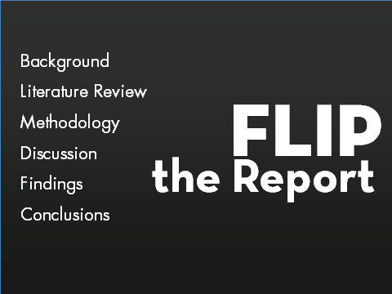
5% Background
20% Bottom Line
Notes:
Then we discussed the Bottom Line, the need to reverse the order in which we present our information to keep the content relevant and interesting. In this section, I introduced the Messaging Model.

Slide 59
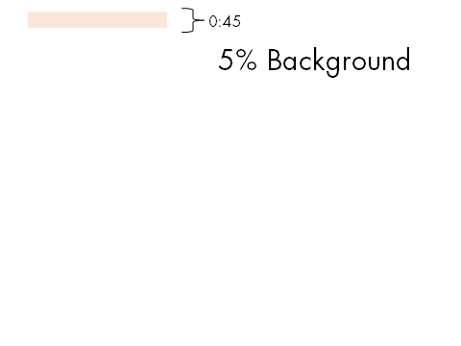
5% Background
20% Bottom Line
50% Explanation
Notes:
Then I explained each section of the Messaging Model, using a metaphor (the focus groups gone bad) and touches of other structures.

Slide 60
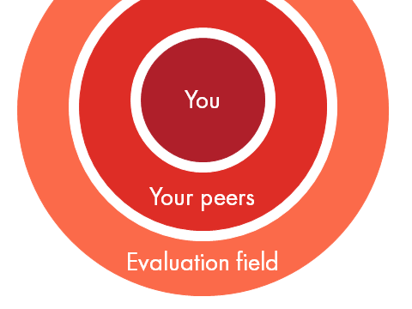
5% Background
20% Bottom Line
50% Explanation
15% So What
Notes:
In my So What section, I explained again how to think about your audience so that you can connect with the heart and mind of each of them.

Slide 61
5% Background
20% Bottom Line
50% Explanation
15% So What
10% Call to Action
Notes:
And now for the call to action.

Slide 62
10 Differences That Make the Difference
Notes:
We’ve been talking about Message, but potent presenters also think about slide design. AEA has another training and several related materials that addres good slide design, so please review those tools as you develop your presentations.

Slide 63

Delivery
Glue
Notes:
Potent presenters also think about Delivery - what to do when up there at the microphone. AEA has a training called Delivery Glue and other tools to support strong delivery.

Slide 64
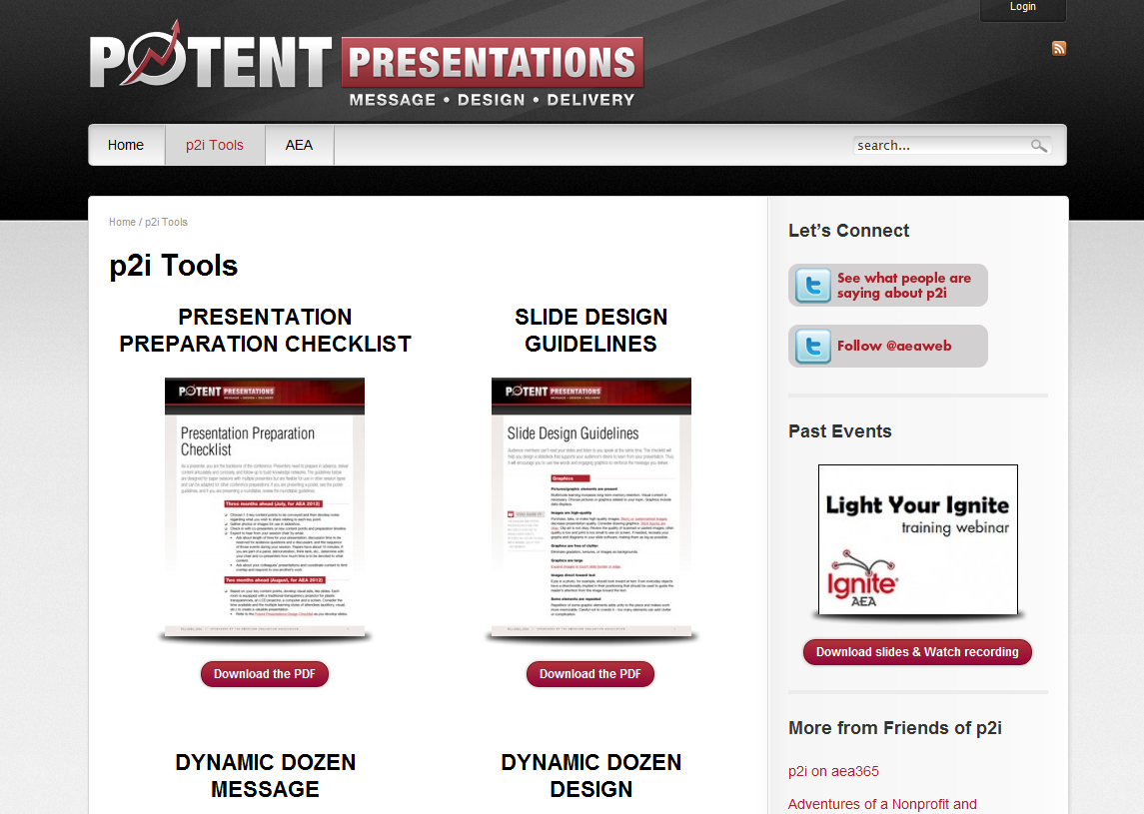
p2i.eval.org
Notes:
All of those materials and more are located on the p2i website, including the slides and handout from today. Please go there and pass along the URL to friends and colleagues.

Slide 65
Connect!
LIST HERE
Notes:
[FILL IN YOUR MANY CONTACT DETAILS ON THIS SLIDE]
And finally, connect with me…
Thanks so much for coming today.

